Slide 1
CSC 4320 Project 2 Presentation
Hyunki Lee
Notes:
Hello. My name is Hyunki Lee
This is operating system project 2 presentation

Slide 2
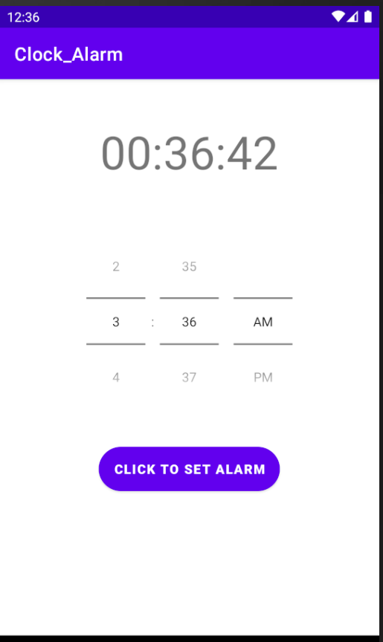
Introduction
The Clock_Alarm application is simply showing
current time, and the app displays time to set an alarm
Notes:
The clock alarm application is a simple app that display current time, and user can set alarm

Slide 3
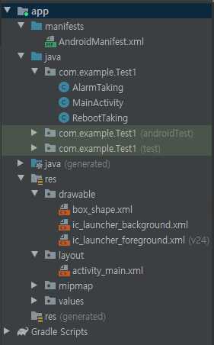
Design Architecture
AndroidManifest.xml
Register necessary authority and receivers
AlarmTaking (BroadcastReceiver)
Popup notification when alarm is going off
App will be showing when a user touches the popup message
MainActivity
Using runnable and handler for displaying current time
Using TimePicker to set alarm time
Using AlarmManager to get notification of alarm
RebootTaking (BroadcastReceiver)
Even though a device is rebooted, alarm system will operate
Activity_main.xml
Holding the app’s appearance
Interaction between a user and an app
Notes:
For Design Architecture
AndroidManifest part is to register necessary authority and receivers
Alarm Taking class part is for popup notification when alarm is going off and app will be showing when user touches the popup message
Main Activity class part is using runnable and handler for displaying current time and using timepicker to set alarm time. Also using Alarm Manager to get notification of alarm
Reboot Taking class part is for that even though a device is rebooted, alarm system will operate
Activity main part is holding the app’s appearance and interact between a user and the app.

Slide 4
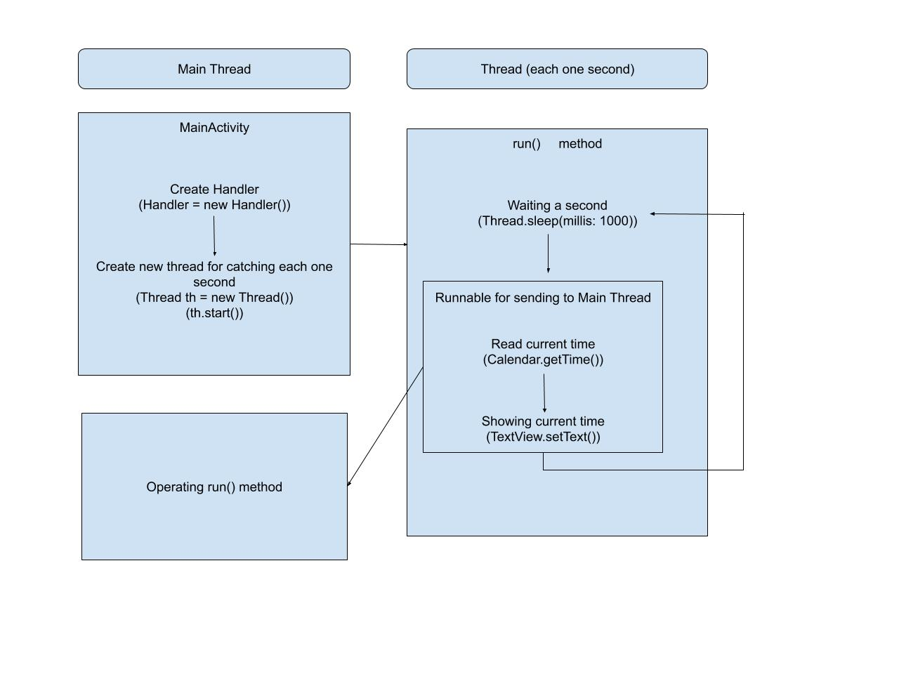
OS – Level Functionalities (Clock)
Notes:
The OS Level functionalities for Clock part are threads. For instance, in main thread, first create handler and then create new thread to implement each one second. Like moving second hand on a clock. The thread will sleep one second. We will get time information using calendar and textview. The information will be sent to main thread to operate run method.

Slide 5
OS – Level Functionalities (Alarm)
BroadcastReceiver
One of the 4 main components of Android OS
Using for receiving alarm, and receiving alarm after rebooting
It is working on background
when a user does not turn off the app
Intent
Intent is a data carrier between 4 main components of Android OS
Intent carries system service to notify background events
Possible to get alarm after rebooting a device
Preference
Save and read simple data (set alarm)
Notes:
The alarm part, mainly Broadcast Receiver, intent and preference are used. Broadcast Receiver is used for receiving alarm and receiving alarm after reboot.
Intent is not exactly OS level function however, Intent carries system service to notify background events
Preference can save and read simple data

Slide 6
Limitation
User can set only one alarm
There is no function for cancelling alarm
Notes:
Limitation of this app is that user can set only one alarm and there is no function for cancelling alarm

Slide 7
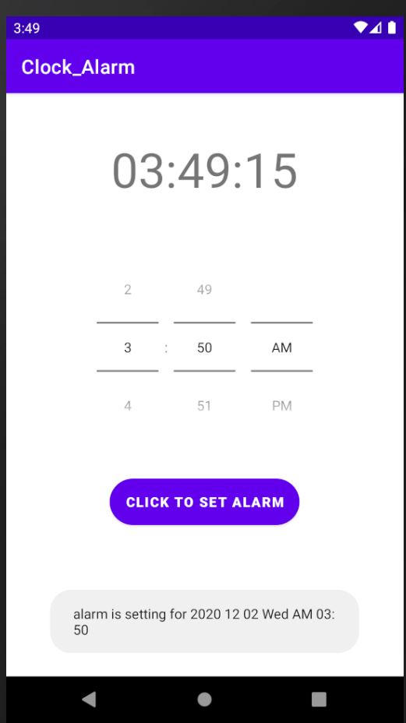
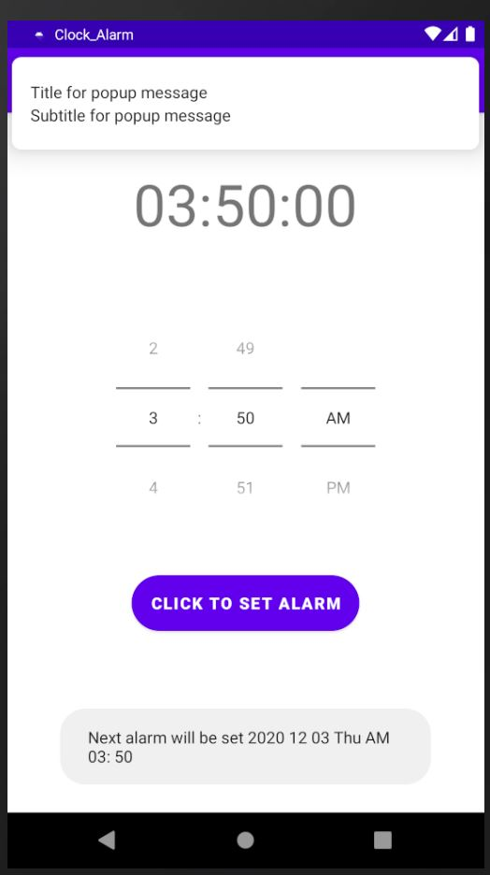
Demo
Notes:
From first picture
We can see the current time on smartphone and current time on app correspond to each other
The bottom of app shows the alarm is set
From the second picture, when alarm goes off, we can see the popup message. Also the bottom of app displays next alarm time.

Slide 8
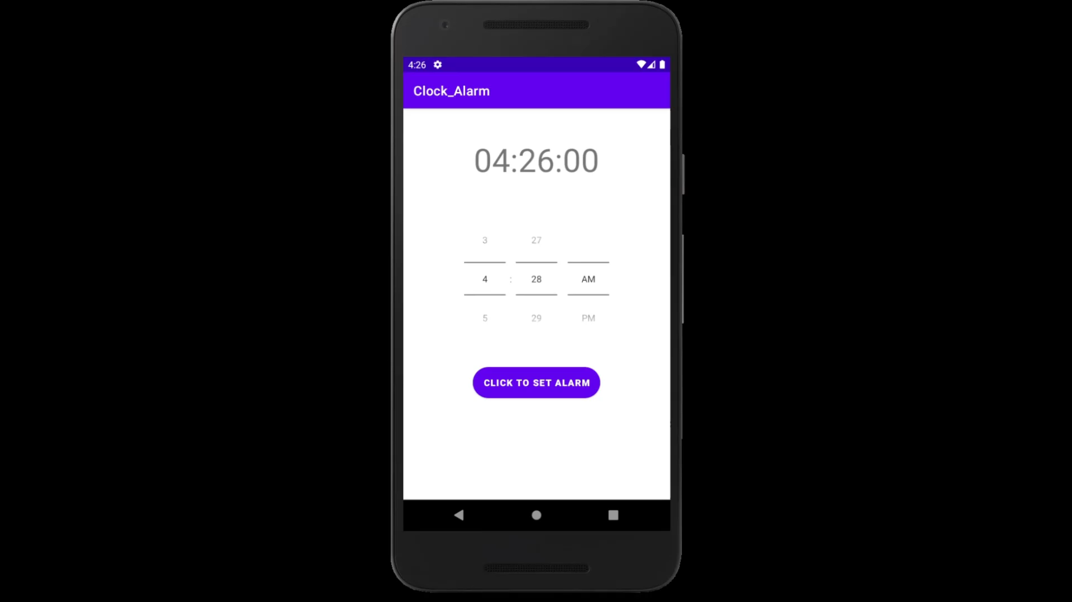
Demo
Notes:
In this demo we will see that the alarm system is working on background and after rebooting device
Set the alarm and restart the device
We can see the message that we set the alarm
When we click the popup message, we can open the app.
Thank you for watching

